Slide 1
Difference in differences method
Econ 426: Isli Kola & Shukhrat Khuseynov

Slide 2
What is diff-in-diff?
Statistical technique
Quantitative research
Treatment group vs. Control group
Panel data
Natural experiment

Slide 3
Card and Krueger (1994)
Minimum wage increase in New Jersey from $4.25 to $5.05 in 1992
Employment in the fast food sectors of both states
 | New Jersey | Pennsylvania | Difference
February | 20.44 | 23.33 | −2.89
November | 21.03 | 21.17 | −0.14
Change | 0.59 | −2.16 | 2.75

Slide 4
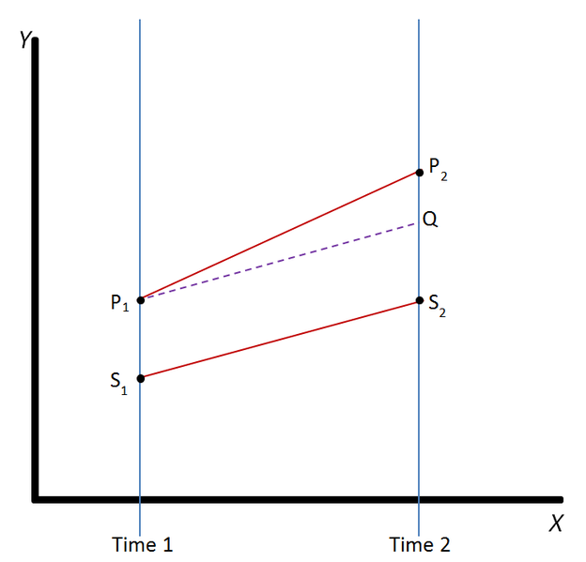

Slide 5





General model
$$Y= α \text{+ }\text{β} T+\text{γ} \text{Dt}\text{ + }\text{δ}\text{(}\text{T}×\text{Dt}\text{) }\text{+ }\text{ε}$$
$$\hat{E} \left(Y \right| T=0, Dt=0)=α$$
$$\hat{E} \left(Y \right| T=0, Dt=1)=α \text{+ }\text{γ}$$
$$\hat{E} \left(Y \right| T=1, Dt=0)=α\text{ + }\text{β}$$
$$\hat{E} \left(Y \right| T=1, Dt=1)=α\text{ + }\text{β}\text{ + }\text{γ}\text{ + }\text{δ}$$

Slide 6

$$Y= α \text{+ }\text{β} T+\text{γ} \text{Dt}\text{ + }\text{δ}\text{(}\text{T}×\text{Dt}\text{) }\text{+ }\text{ε}$$
 | Treatment group (T=1) | Control group (T=0) | Difference
Before the treatment (Dt=0) | α + β | α | β
After the treatment (Dt=1) | α + β + γ + δ | α + γ | β + δ
Change | γ + δ | γ | δ

Slide 7

Estimation (Stata)
Card & Krueger (1994)
$$\hat{FTE}= α \text{+ }\text{β} State+\text{γ} \text{After}\text{ + }\text{δ}\text{(}\text{State}×\text{After}\text{)}$$
First way

Slide 8
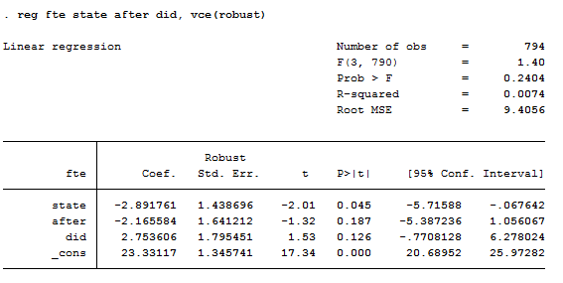

$$\hat{FTE}= α \text{+ }\text{β} State+\text{γ} \text{After}\text{ + }\text{δ}\text{(}\text{State}×\text{After}\text{)}$$

Slide 9
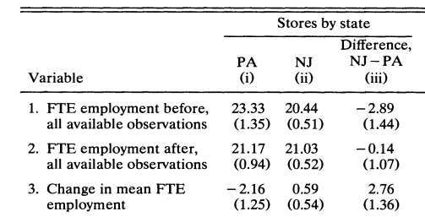
Card & Krueger (1994)

Slide 10
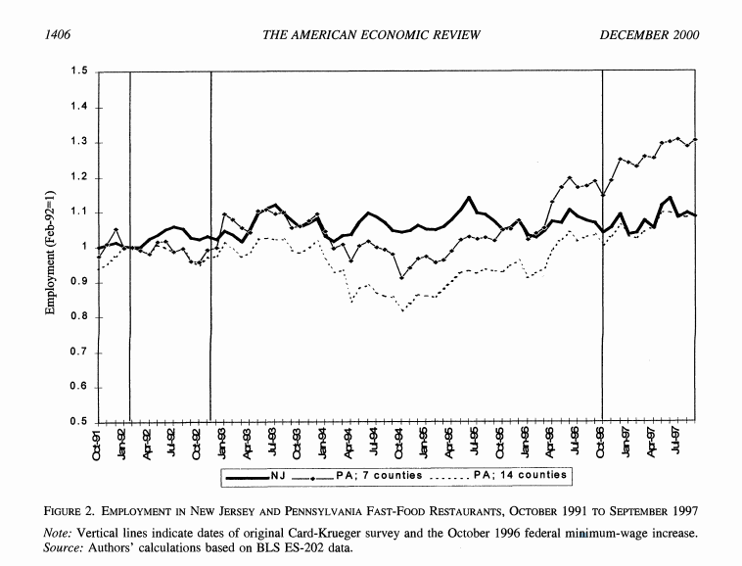
Card & Krueger (2000)

Slide 11
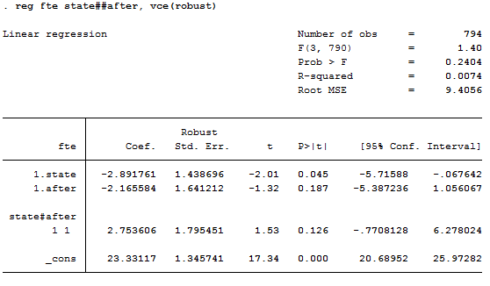
Second way

Slide 12
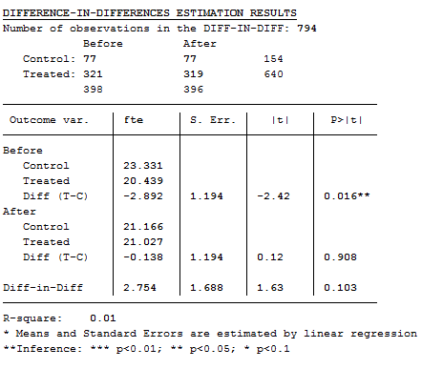
Third way

Slide 13
References
Card, D., & Krueger, A. (1994). Minimum Wages and Employment: A Case Study of the Fast Food Industry in New Jersey and Pennsylvania. The American Economic Review, 84(4). Retrieved December 19, 2018, from http://davidcard.berkeley.edu/papers/njmin-aer.pdf
Card, D., & Krueger, A. (2000). Minimum Wages and Employment: A Case Study of the Fast-Food Industry in New Jersey and Pennsylvania: Reply. The American Economic Review, 90(5), 1397-1420. Retrieved from http://www.jstor.org/stable/2677856
Difference in differences. (2018, December 11). Retrieved December 19, 2018, from https://en.wikipedia.org/wiki/Difference_in_differences
Torres ‐ Reyna, O. (n.d.). Differences-in-differences (using Stata) [Scholarly project]. In Princeton University. Retrieved December 20, 2018, from http://www.princeton.edu/~otorres/DID101.pdf

Slide 14

Thank you for your attention!

Slide 15
The End

